Slide 1
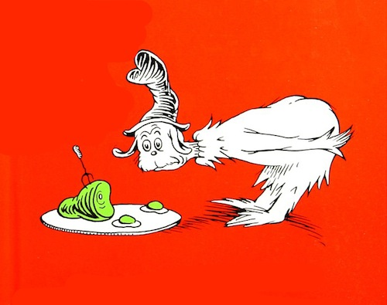
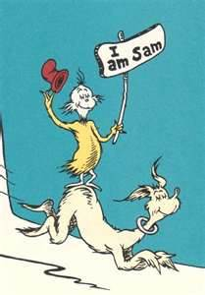
Green Eggs and Ham
By Dr. Seuss
Power Point By Corinne Perry

Slide 2
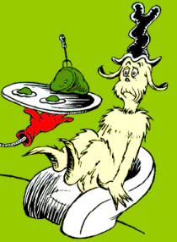
Do you like Green Eggs and Ham?
I do not like them, Sam I am. I do not like green eggs and ham.

Slide 3
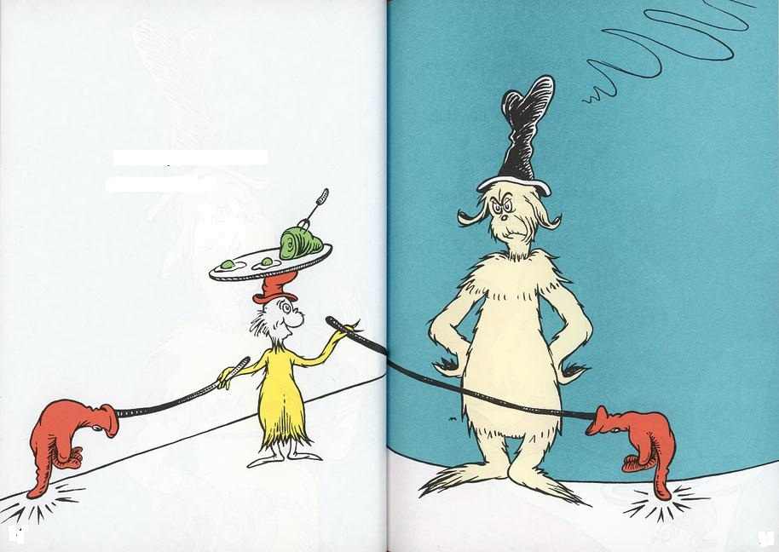
Would you like them here or there?
I would not like them here or there. I would not like them anywhere. I do not like green eggs and ham. I do not like them Sam I am.

Slide 4
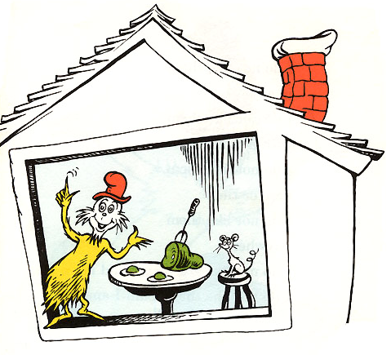
Would you like them in a house?
Would you could you with a mouse?
I do not like them in a house or with a mouse . I do not like them anywhere. I do not like green eggs and ham. I do not like them Sam I am!

Slide 5
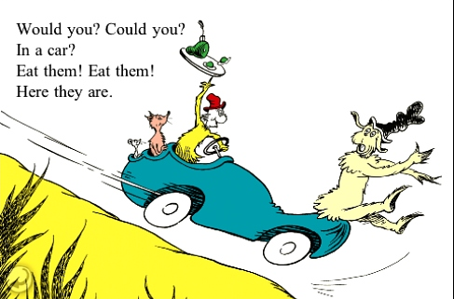
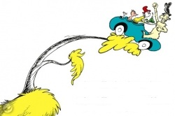
I would not,
Could not, in a car.
You may like them in a tree!
I would not, could not in a tree. Not in a car! You let me be!

Slide 6
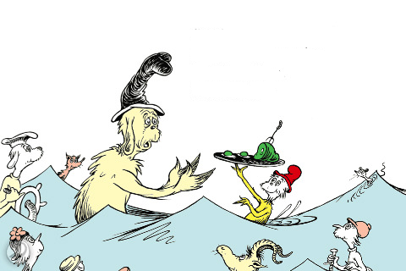
You do not like them.
So you say.
Try them! Try them!
And you may.

Slide 7
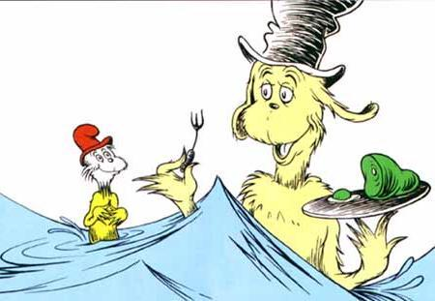
Say!
I like green eggs and ham!
I do! I like them Sam I am!
I would eat them here or there.
And I would eat them in a House.
And I would eat them with a mouse.
And in a car. And in a tree.
I would eat them anywhere!

Slide 8
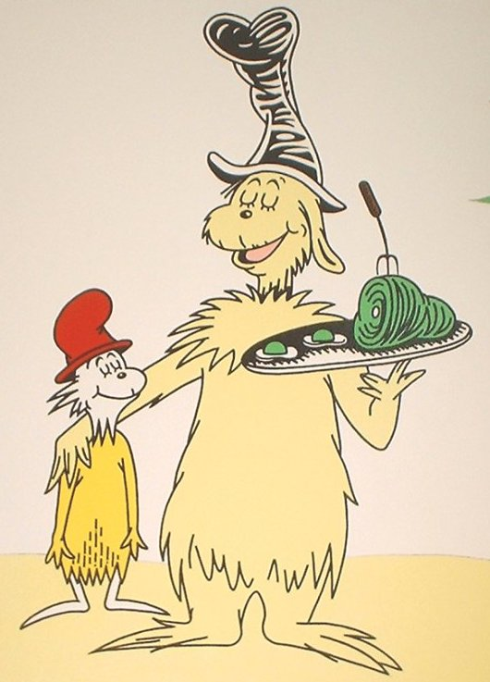
I do so like green eggs and ham!
Thank you!
Thank you,
Sam I am!

Slide 9
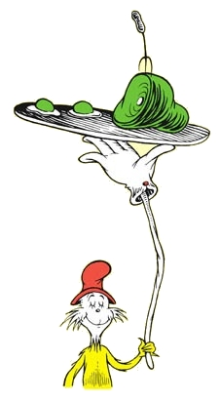
THE END!

